Slide 1


Datacamp: Musical Recommandation
Presented by Axel Autogue, Léna Brunier and Boris Colin

Slide 2
Summary:
Introduction
Our team
The market
The Application
The Data
The Models
Conclusion

Slide 3

Introduction:
Our goals :
Recommend music based on the user’s tastes
Be fast and easy to use
Have a low environmental impact

Slide 4



Our Team
Léna Brunier (DE)
Website development
Axel Autogue (BI)
Data engineer
Boris Colin (DAI)
Machine Learning

Slide 5
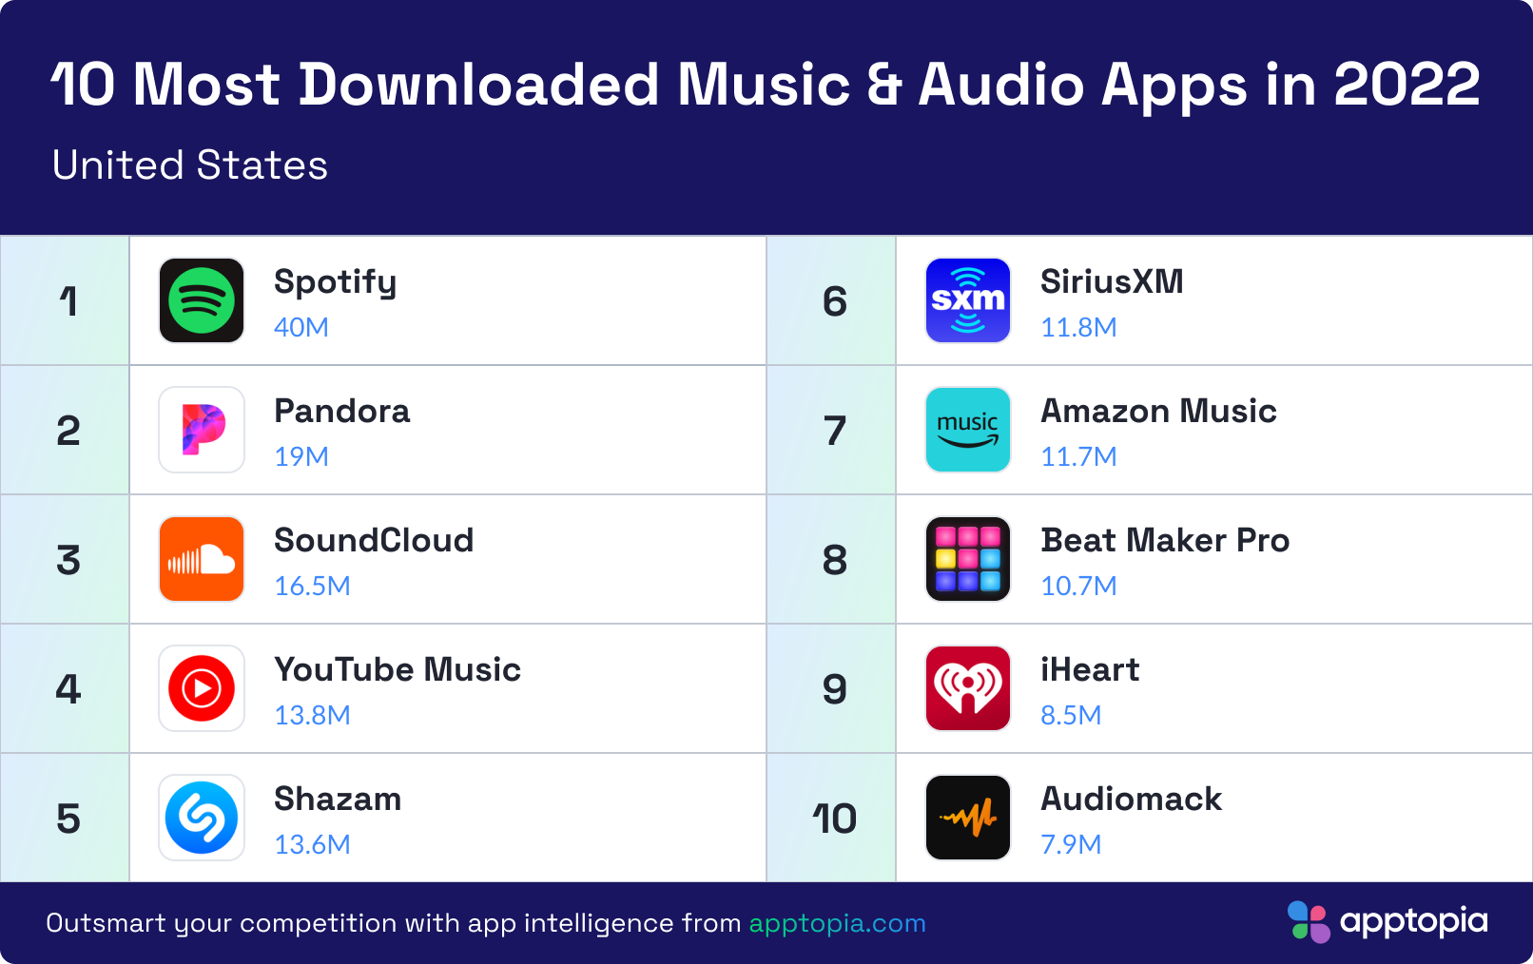

Slide 6
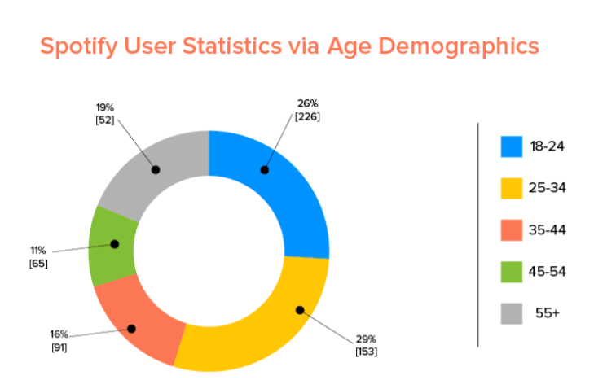
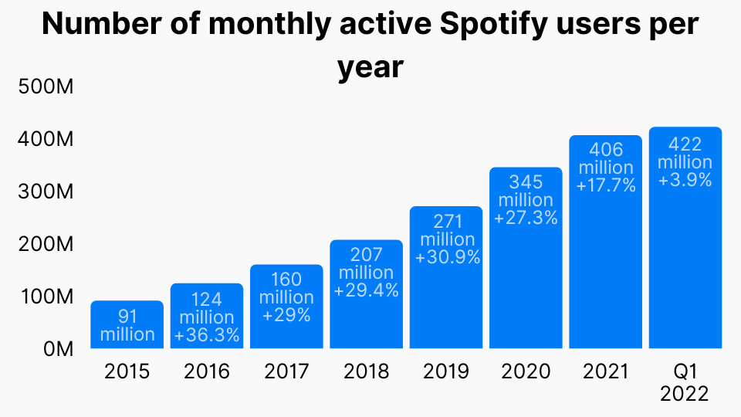
The market:

Slide 7
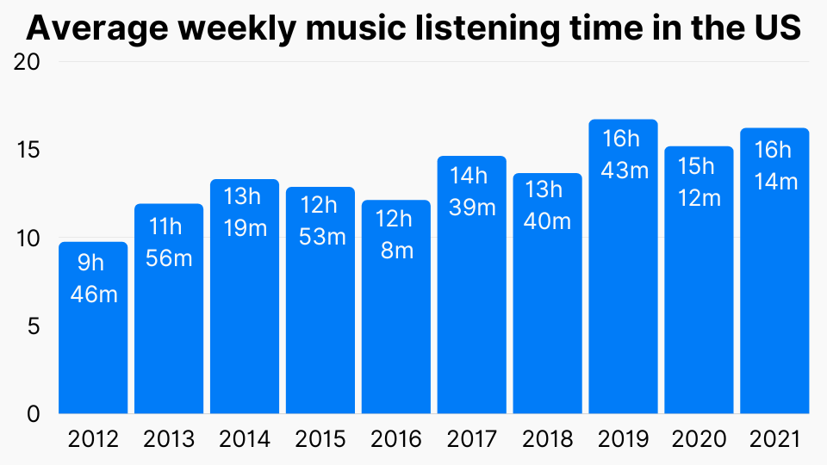

Slide 8
The Application
Provides recommendation
Intuitive usage
Fast
Respects the environment

Slide 9
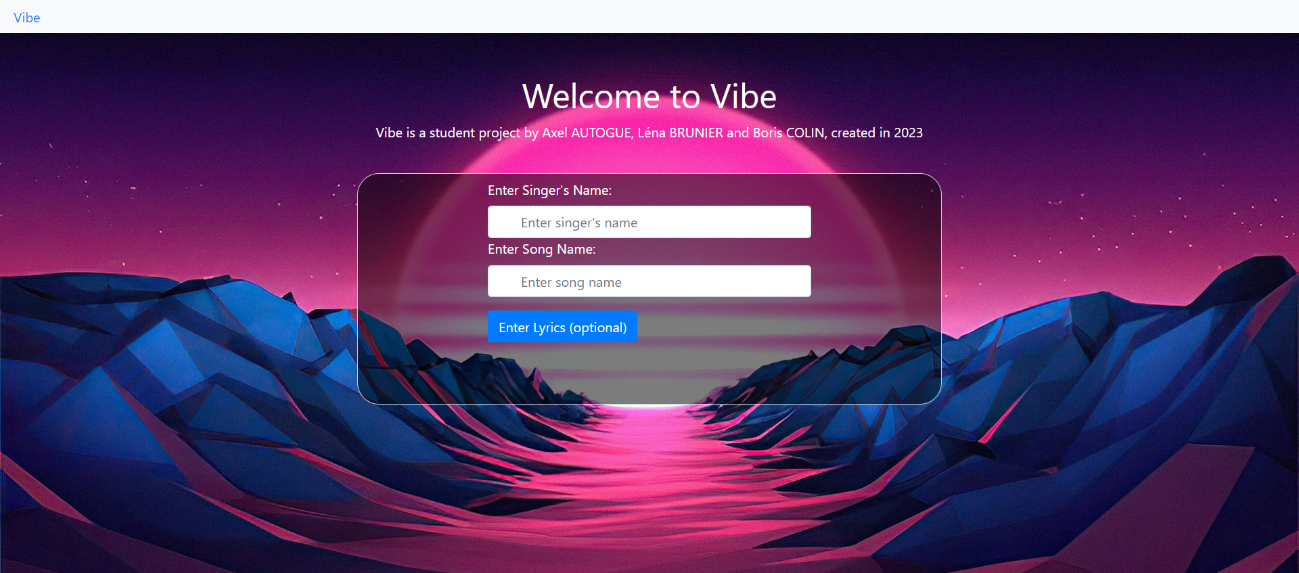
Intuitive usage:

Slide 10

Respect of the Environnement:

Slide 11
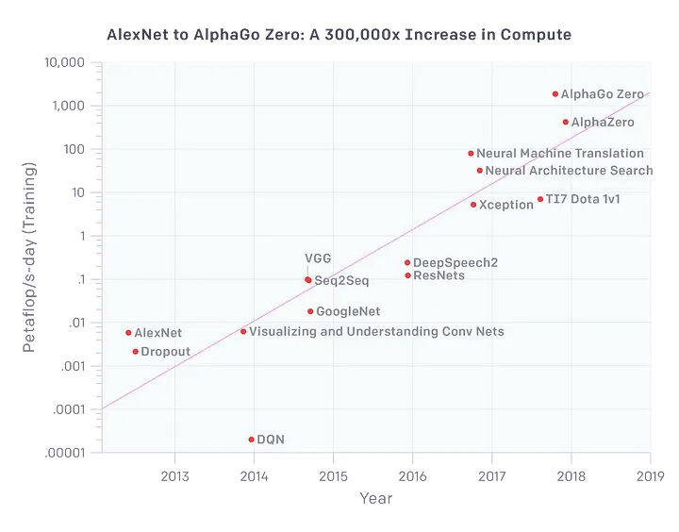
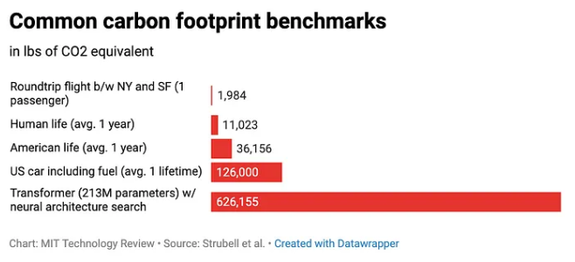
CO2 emissions

Slide 12
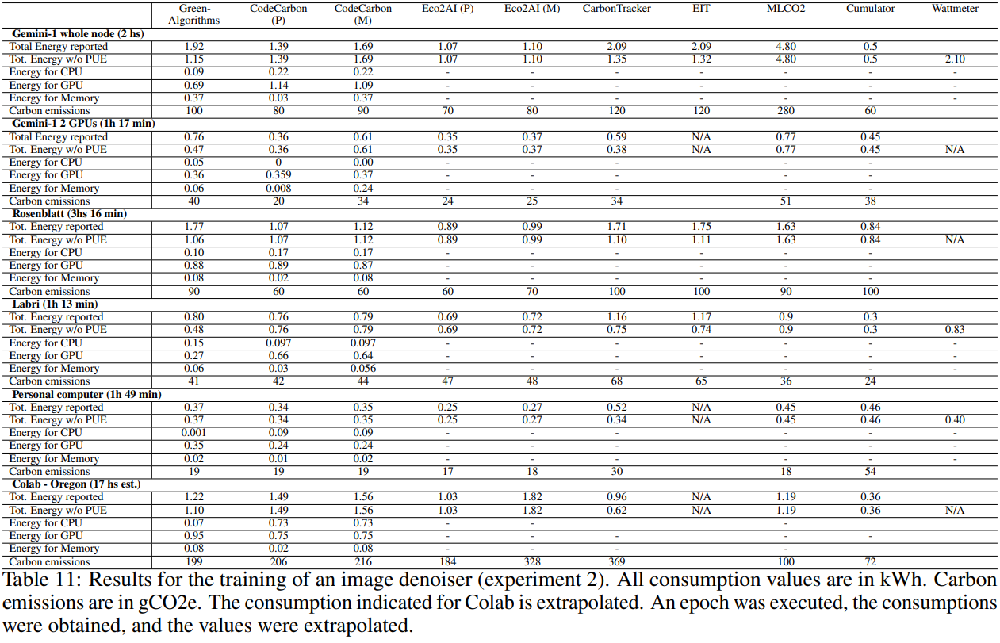
Our case:
For 1s of training : 0,00325g of CO2
https://hal.science/hal-04120582/document

Slide 13

Our data, and its treatement:
Overview
Points of interest
Filling the gaps

Slide 14
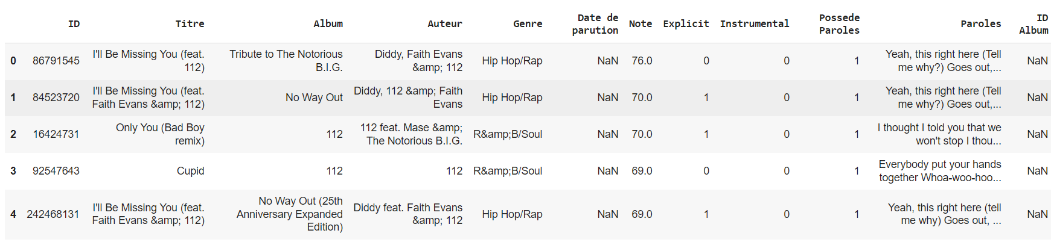
Original dataset:

Slide 15


A large database:

Slide 16
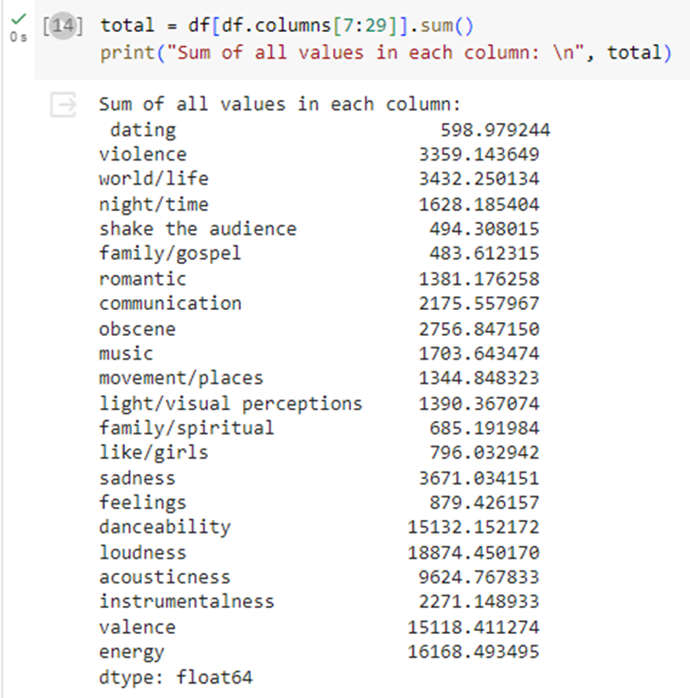
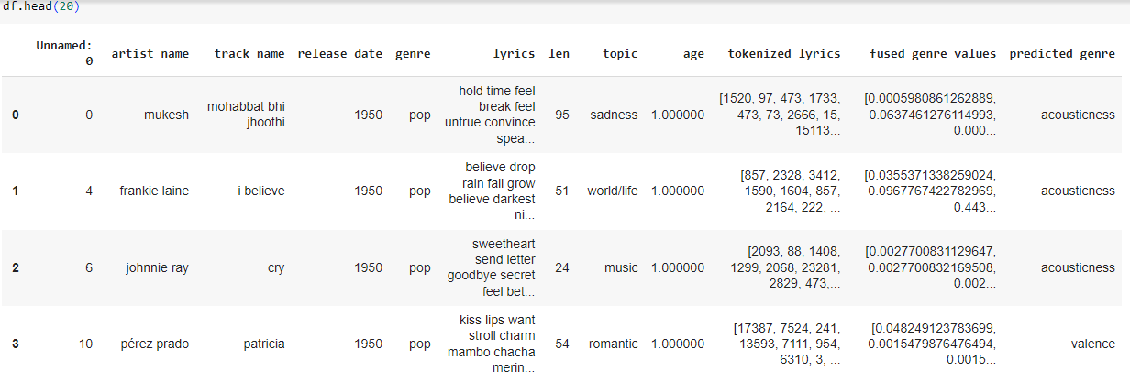
The columns of interest

Slide 17
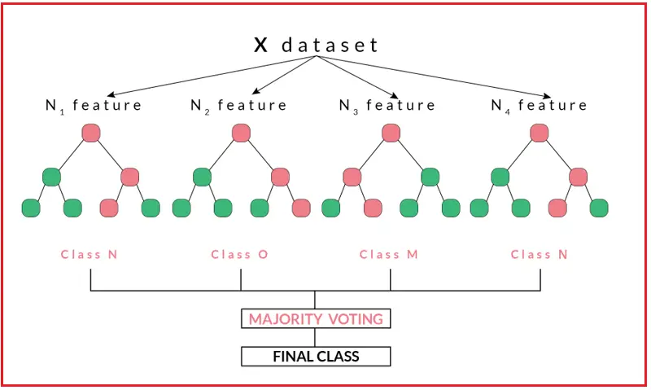
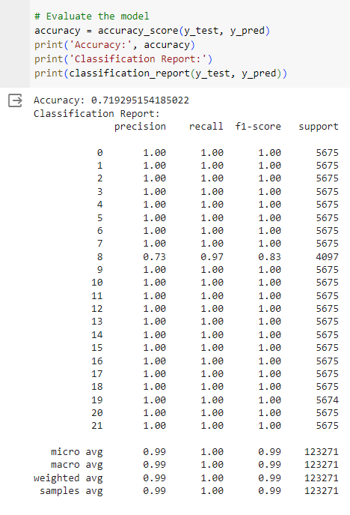
The search for the model: Random Forest

Slide 18


Deep Learning

Slide 19
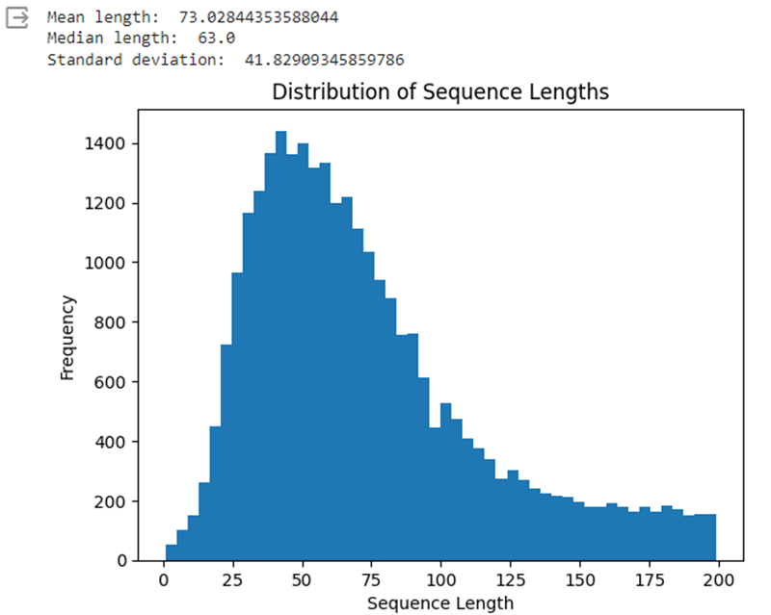
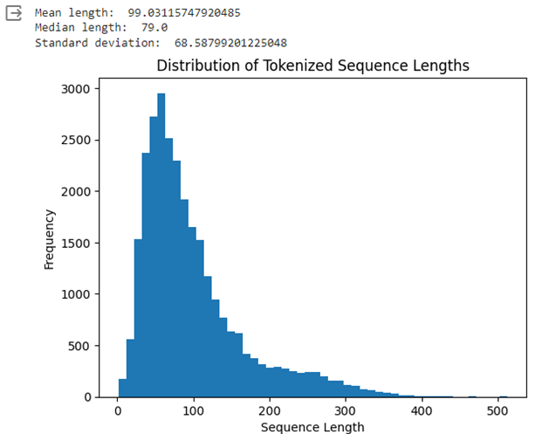
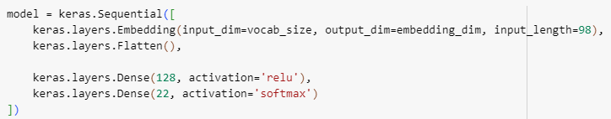
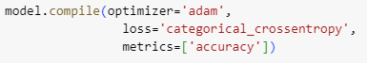
The model:

Slide 20
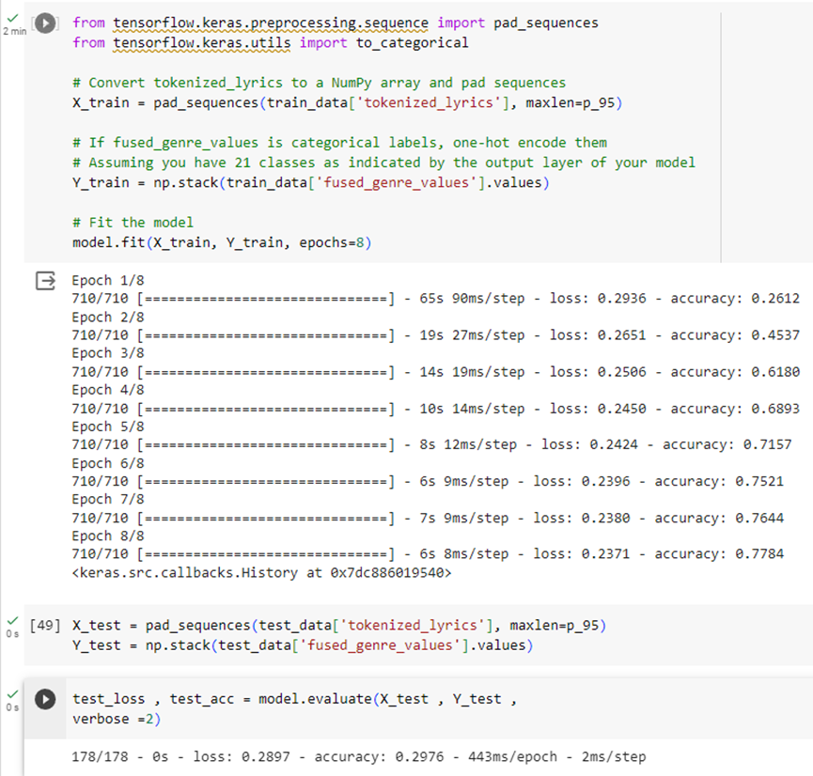
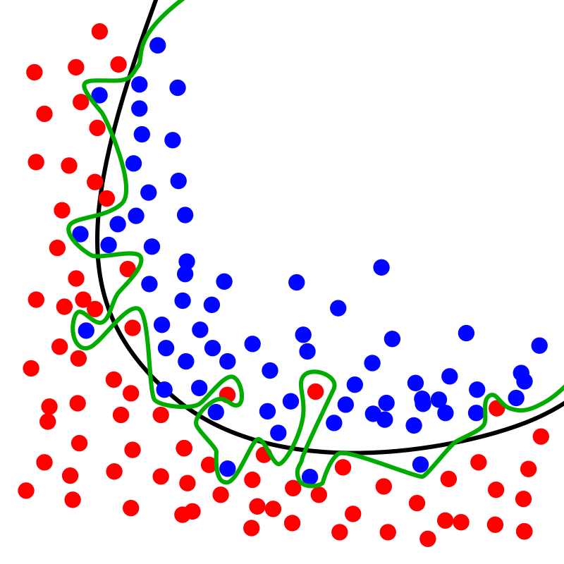
First attempt:
Overfitting Risk

Slide 21
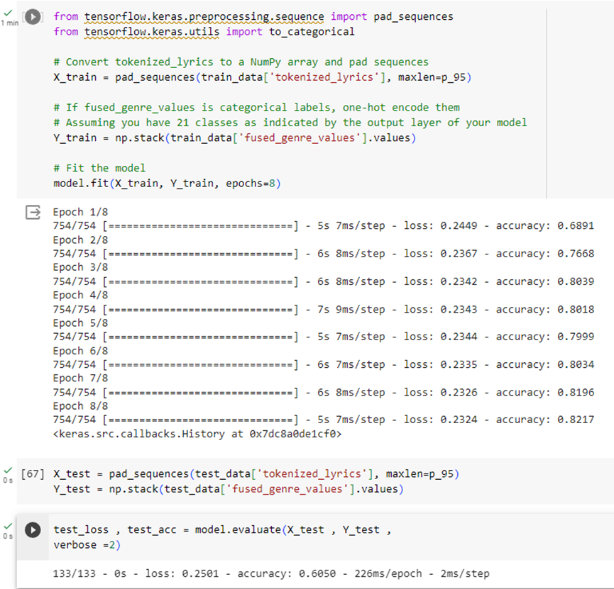
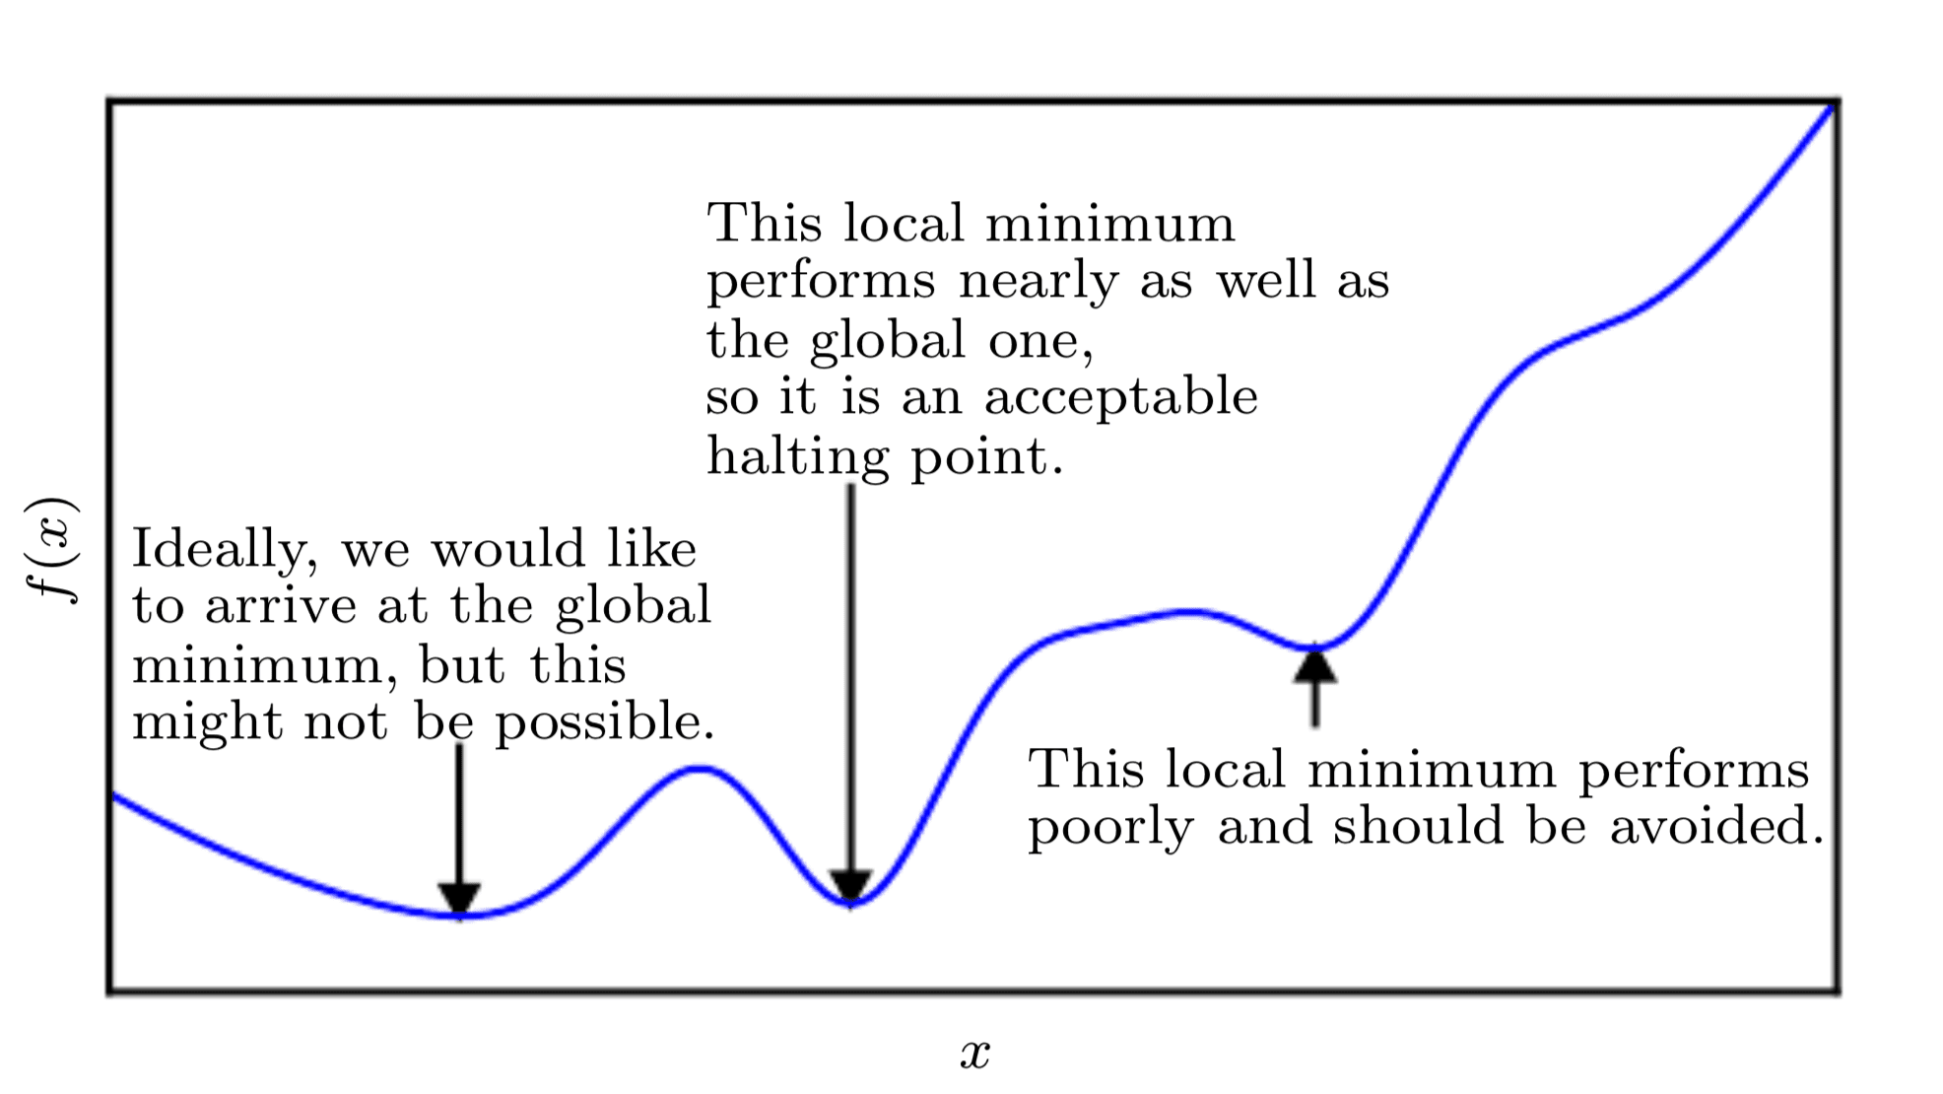
Second attempt:

Slide 22
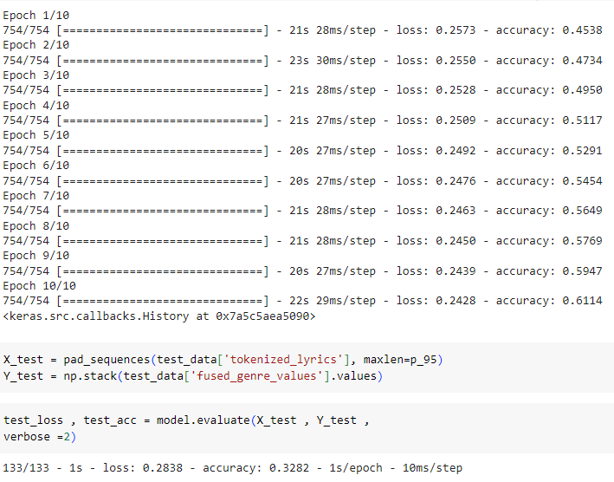
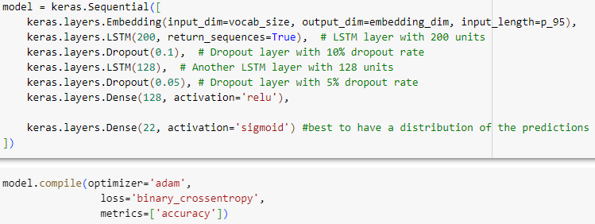
Third try:

Slide 23
Conclusion
Amelioration points:
Try different kinds of tokenizers and embeddings
Use a language selection system
Spotify interactions
Filtered search
Review system to improve the model over time

Slide 24
Sources and References:
https://www.google.com/url?sa=i&url=https%3A%2F%2Fheadphonesaddict.com%2Fspotify-statistics%2F&psig=AOvVaw1Q-5VFQtko8EQK5HDdpXt5&ust=1698653695831000&source=images&cd=vfe&opi=89978449&ved=0CBIQjRxqFwoTCPiy2aLomoIDFQAAAAAdAAAAABAJ
https://www.google.com/url?sa=i&url=https%3A%2F%2Fblog.apptopia.com%2Fworldwide-and-us-download-leaders-2022&psig=AOvVaw1StGrczv14KFO9gbcJN2N8&ust=1698653965229000&source=images&cd=vfe&opi=89978449&ved=0CBIQjRxqFwoTCIDwnKPpmoIDFQAAAAAdAAAAABAJ
https://www.kaggle.com/datasets/saurabhshahane/music-dataset-1950-to-2019/code
https://www.kaggle.com/code/michalbaron/song-s-topics-classification-with-pytorch/notebook
https://www.tensorflow.org/tutorials/keras/text_classification?hl=fr
https://medium.com/@tenzin_ngodup/simple-text-classification-using-random-forest-fe230be1e857
https://www.kaggle.com/code/blurredmachine/bag-of-words-meets-random-forest
https://towardsdatascience.com/deep-learning-and-carbon-emissions-79723d5bc86e
https://hal.science/hal-04120582/document

